Slide 1
COMPUTER NETWORKING
PROJECT

Slide 2
TOPICS TO COVER
Basics Point Networking
Networking Types
Networking Topologies
Networking Devices
Transmission Modes
OSI Model
TCP/IP Model

Slide 3
BASIC POINT NETWORKING
Network
Networking
Internet
Message OR Token
Architecture

Slide 4
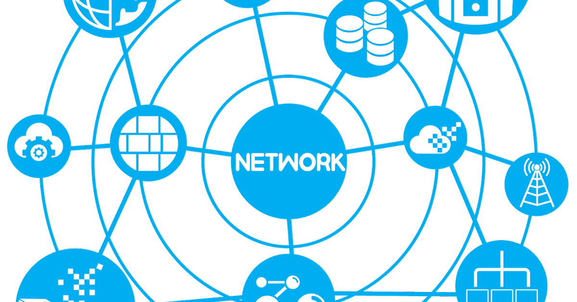
Network
A Network consists of two or more computer that liked in order to share resources, exchange file or communication.

Slide 5
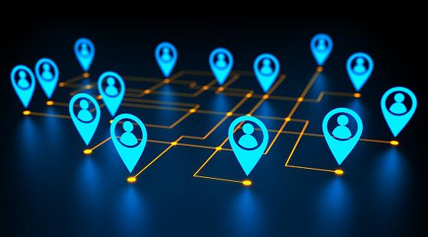
Networking
Networking, Also known as computer networking is the of transporting & exchanging data or information & having communication between connected nodes over a shared medium.

Slide 6

Internet
“Collection of networks is known as internet”.
Advance Research Projects Agency Network

Slide 7
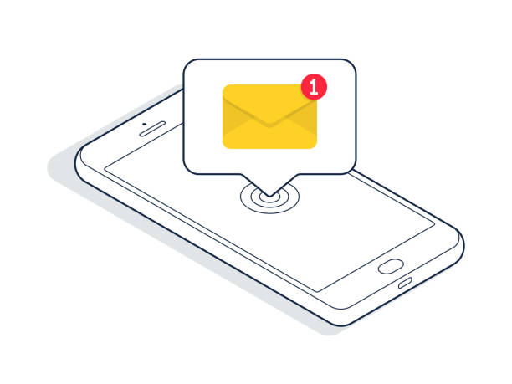
Message Or Token
when one of the system on the network has the “token”. It can send information to the other networks.

Slide 8
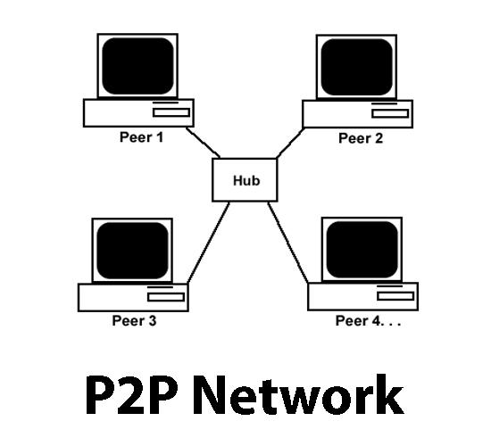
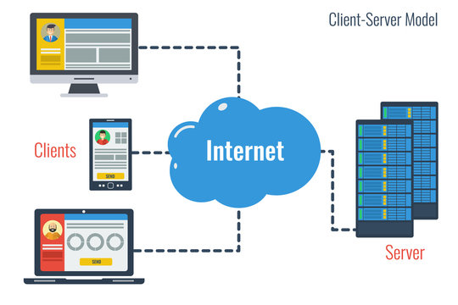
Architecture
Peer-to-peer Model
Client-Server Model
Decentralized Network
Centralized Network

Slide 9
NETWORKING TYPES
LAN Network
WAN Network
MAN Network
PAN Network
CAN Network

Slide 10
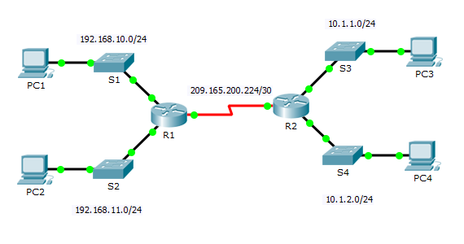
Local Area Network(LAN)
“Most frequently used Network”. A LAN Network a computer Network that connects computer together through a common communication path, contained within a limited area wired & wireless.

Slide 11
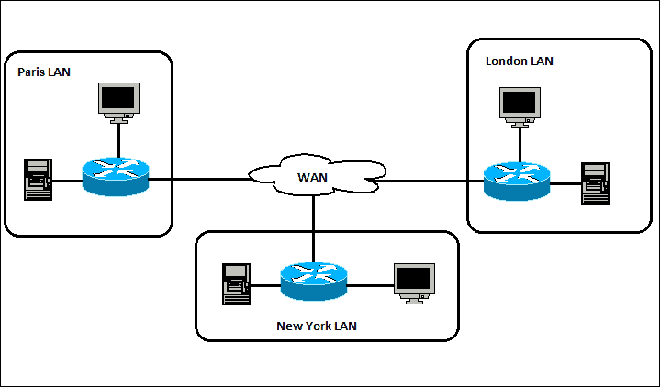
Wide Area Network(WAN)
WAN is a type of computer network that connects computer over a large “geographical” distance through a shared communication path, Also be defined as a group of local area network that communication with each other.

Slide 12
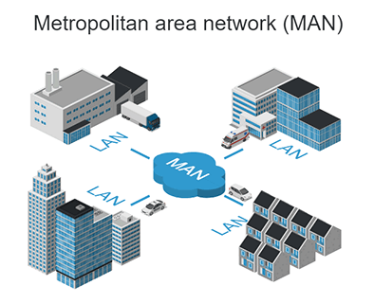
Metropolitan Area Network(MAN)
A Metropolitan Area Network a large than a LAN but smaller than a WAN.

Slide 13
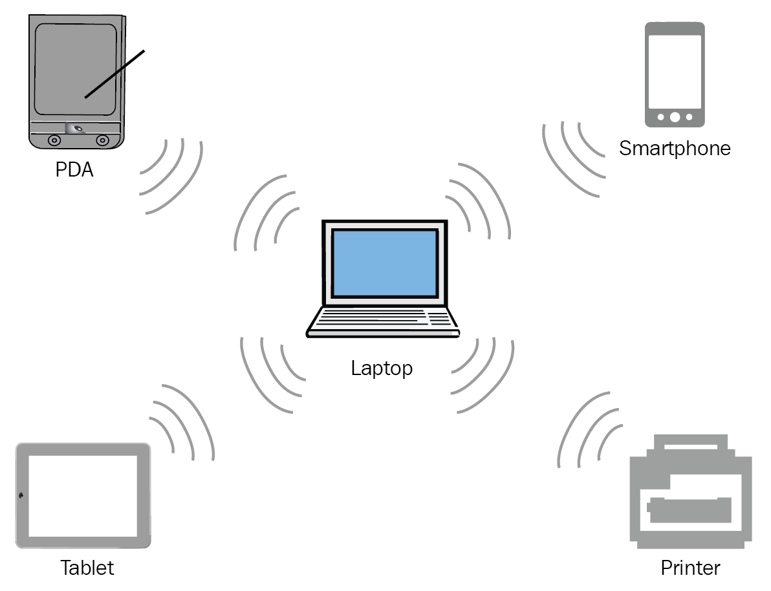
Personal Area Network(PAN)
“This Network is restrained to a single person” range about 10 meters around.

Slide 14
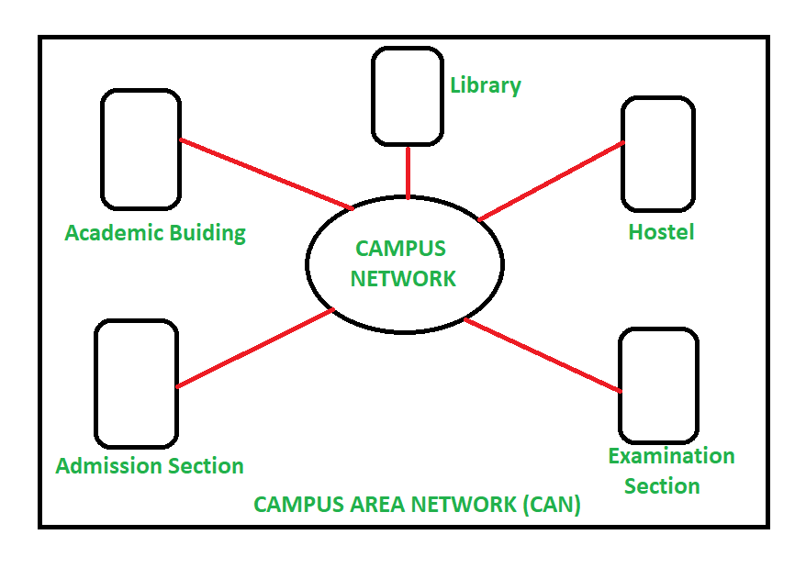
Campus Area Network(CAN)
Campus Area Network is bigger than a Local Area Network(LAN) but smaller than a Metropolitan Area Network(MAN) this cover a limited geographical area.

Slide 15
NETWORKING TOPOLOGIES
Bus Topologies
Star Topologies
Ring Topologies
Tree Topologies
Mesh Topologies
Hybrid Topologies

Slide 16
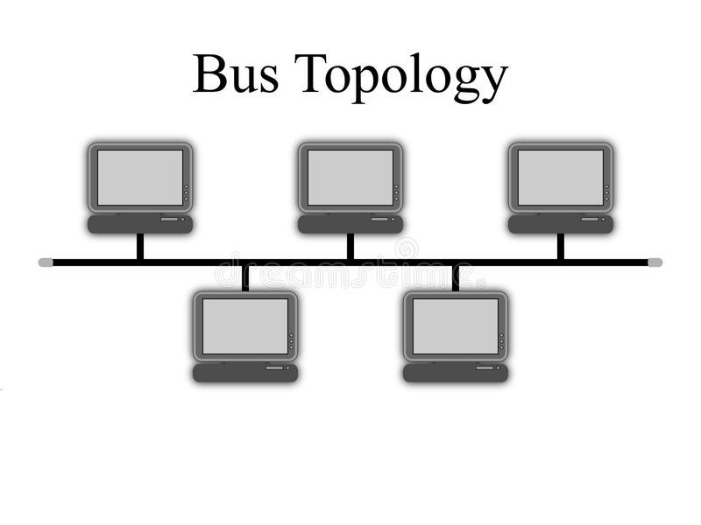
Bus Topologies
The bus topologies is designed in such a way that all the station are connected through a single cable known as a backbone cable, Bus topologies are also called “LINE TOPOLOGIES”

Slide 17
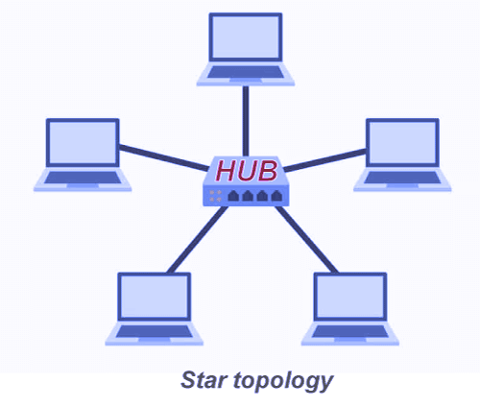
Start Topologies
Start topologies is an arrangement of the network in which every node is connected to the central hub.

Slide 18
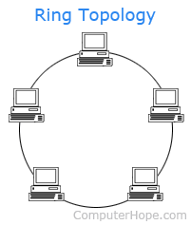
Ring Topologies
Ring topologies is like a bus topologies but with connected ends, the most common access method of the ring topologies is “token passing”.

Slide 19
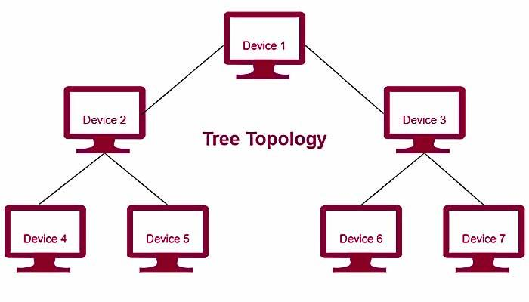
Tree Topologies
Tree topologies combines the characteristic of bus topologies & start topologies, A tree topologies is a type of structure in which all the computer are connected with each in hierarchical fashion.

Slide 20
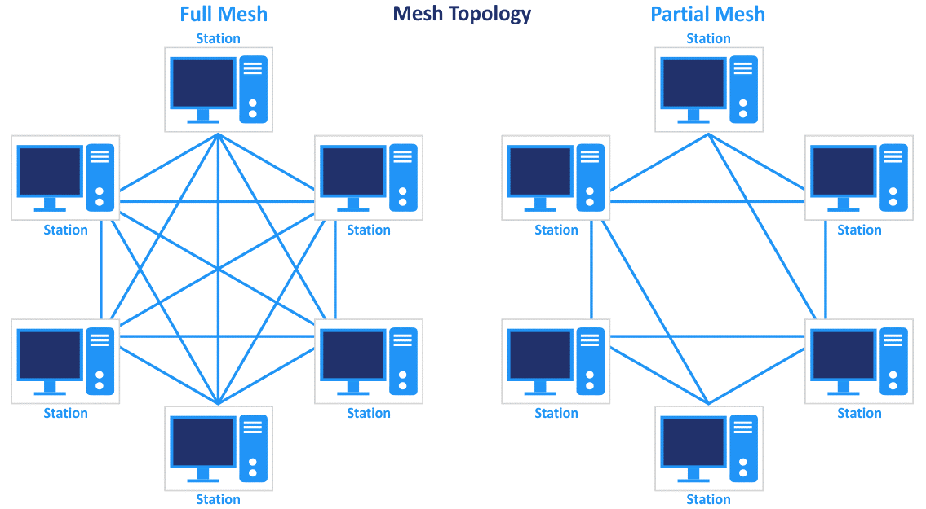
Mesh Topologies
Mesh topologies type of topologies a host is connected to one or multiple hosts.
There are two type-
Full Mesh Topologies
Partially Mesh Topologies

Slide 21
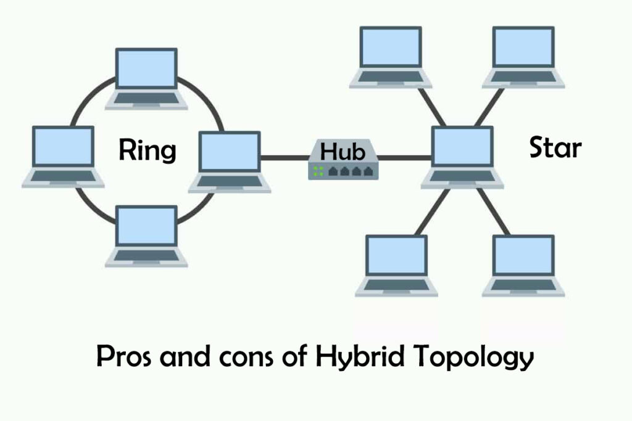
Hybrid Topologies
The combination of various different topologies is known as hybrid topologies.

Slide 22
NETWORKING DEVICES IN NETWORK
Hub
Switch
Router
Nic card
Repeater
Modem
Bridge
Gateway

Slide 23
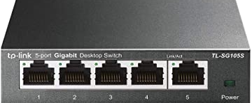
Hub
A hub is basically a multiple repeater, A connects multiple wire form different branches, for example the connector in star topologies , which connects different stations, one port input & another port output.

Slide 24
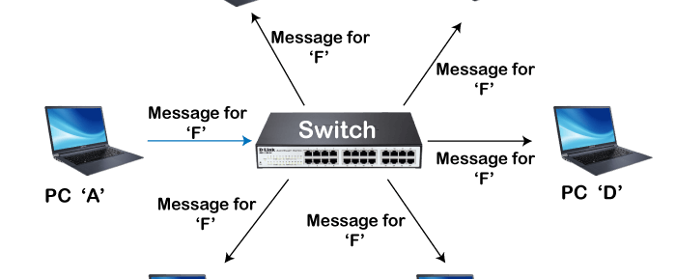
Switch
Switch hardware device that connects multiple devices on a computer network ,This is advance feature computer networking.

Slide 25
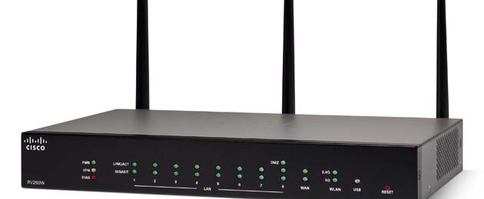
Router
A router is a device like a switch that data packets based on their IP address, A router forwards the packets based on the information available in the routing table.

Slide 26
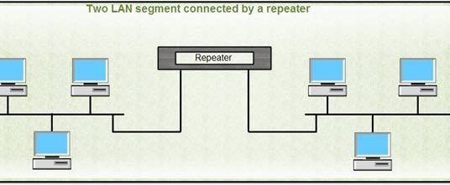
Repeater
A repeater is networking device important point to be noted about repeater is that they do amplify single.

Slide 27
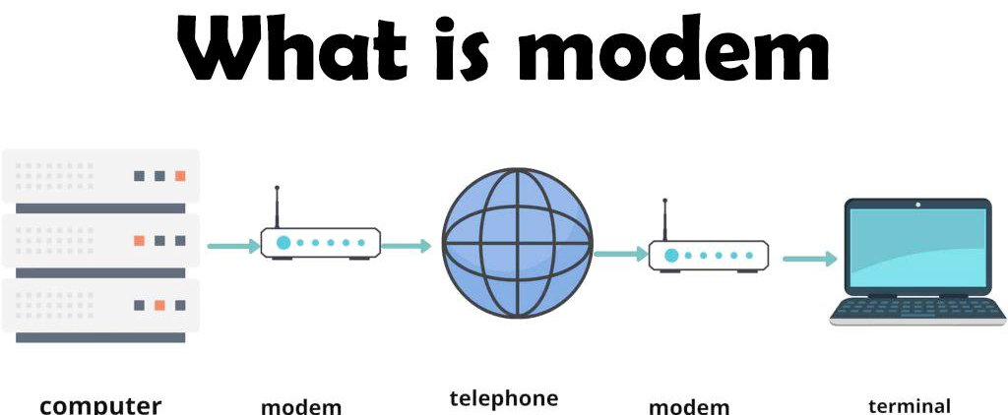
Modem
It stands for “modulator-demodulator”, It converts the digital data into an Analog single over the telephone lines.

Slide 28
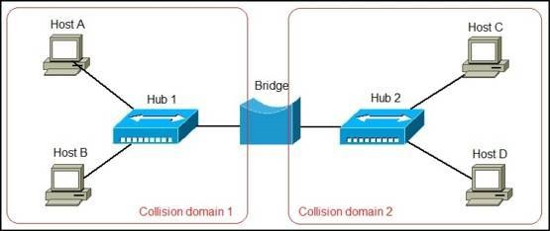
Bridge
Bridge is a repeater with add on the functionality of filtering content by reading the mac address of source & destination.

Slide 29
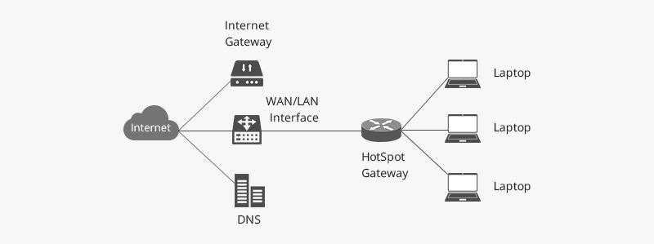
Gateway
A gateway is a network node that forms a passing between two network operating with different transmission protocol, convert information data other protocol another.

Slide 30
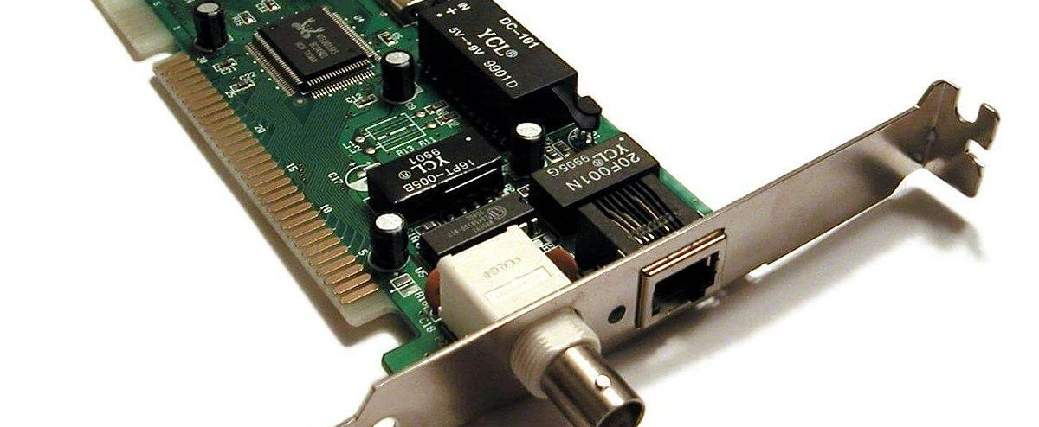
Nic card
NIC(Network Interface Card/Controller) used to connect the computer to the network, wired & wireless MAC address stored in the NIC card.

Slide 31
TRANSMISSION MODES
Transmission
Simplex-Mode
Half-Duplex-Mode
Full-Duplex-Mode

Slide 32
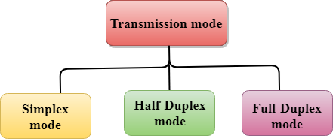
Transmission Control Mode
The way in which data is transmitted one device to another device is known as transmission mode.

Slide 33
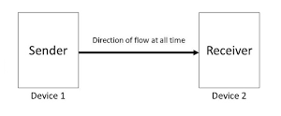
Simplex-Mode
One way transmission data flow one direction.

Slide 34
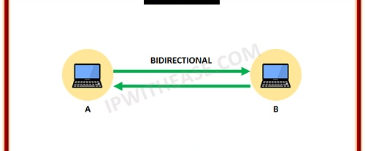
Half-Duplex-Mode
In half-duplex channel the station can transmitted & receive the data as well both direction.

Slide 35
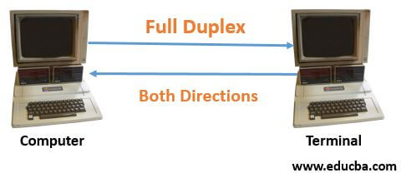
Full-Duplex-Mode
Data flow both direction both station are can send & receive the message simultaneously.

Slide 36
OSI MODEL
Explain OSI Model
Explain OSI Model Layer

Slide 37
OSI Model(open system interconnection model)
The OSI model(open systems interconnection model) is a conceptual framework used to describe the of a networking system, OSI model have contain 7 layers.

Slide 38
APPLICATION LAYER
PRESENTATION LAYER
SESSION LAYER
TRANSPORT LAYER
NETWORK LAYER
DATA LINK LAYER
PHYSICAL LAYER

Slide 39
Application Layer
An application layer is an abstraction layer that specifies that shared communication protocols and interface methods used by hosts in a communication network, application-layer protocols are includes are DNS, HTTP, FTP, SMTP, DHCP.

Slide 40
Presentation Layer
Presentation layer is as the data translator for the network, it is sometimes called the syntax layer, presentation layer protocols are include
XDR,NDR,NCP.

Slide 41
Session Layer
Session layer provides the for opening, closing session between end-user application processes, session layer protocols are include are NetBIOS, PAP, SMPP, SCP.

Slide 42
Transport Layer
An transport layer provides end-to-end communication services for application, transport layer protocols are used for TCP and UDP protocols,

Slide 43
Network Layer
Network layer is responsible for packet forwarding including routing through intermediate routes, network layer protocols used are IP address, ICMP, IGMP.

Slide 44
Data Link Layer
Data link layer is the protocol layer that transfers data between nodes on a network segment across the physical layer, protocols are used ARP, LLDP.

Slide 45
Physical Layer
Physical layer provides an electrical, mechanical, and procedural interface to the transmission medium, physical layer are use protocols like as USB, Bluetooth.

Slide 46
TCP/IP MODEL
Explain TCP/IP Model
Layers of TCP/IP Model

Slide 47
TCP/IP(Transmission Communication Protocol and Internet Protocol)model
Communication protocol used in the Internet and similar computer networks, the current protocol in the suite are the Transmission Communication Protocol (TCP) and the Internet Protocol(IP), as well as the User Datagram Protocol(UDP).

Slide 48
Layer of TCP/IP Model
Application Layer
Transport Layer
Internet Layer
Network Interface Layer

Slide 49
THANK YOU

